Slide 1
Order Processing
System
By Code Crafters

Slide 2
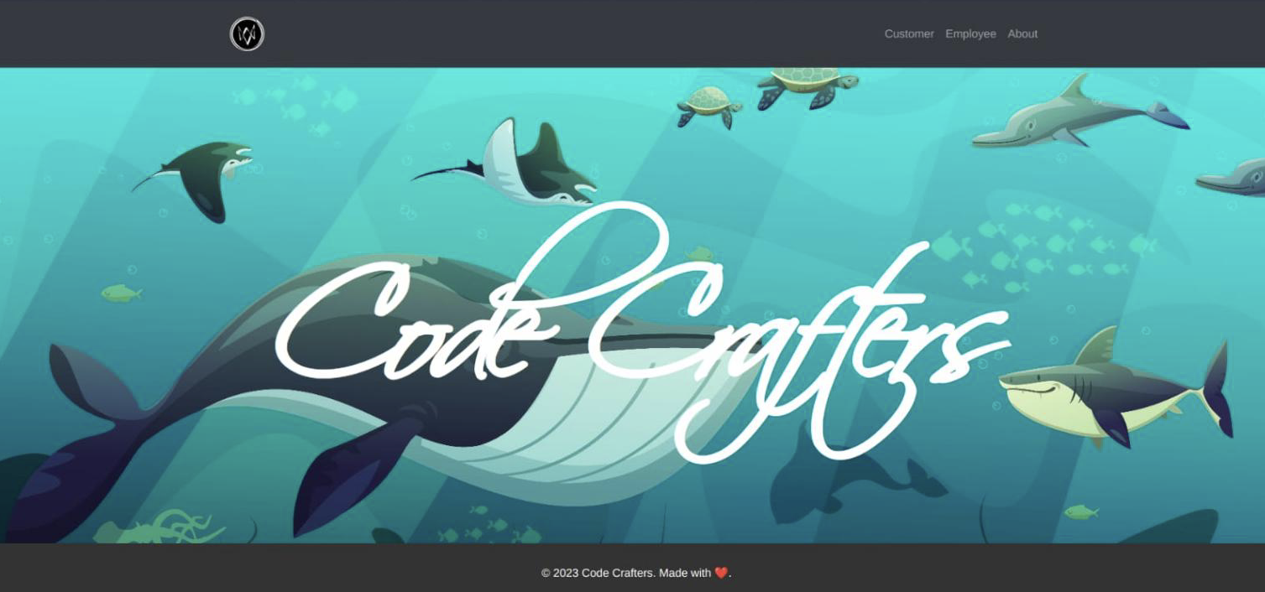
Streamlining efficiency and enhancing customer satisfaction
Simplifies the act of creating/maintaining and processing orders.

Slide 3


1. Divisions
Front-end
JS/CSS/HTML
Back-end Java, JDBC, SQL
Documentation Tries to answer -> What? How? Why? Where? When?

Slide 4
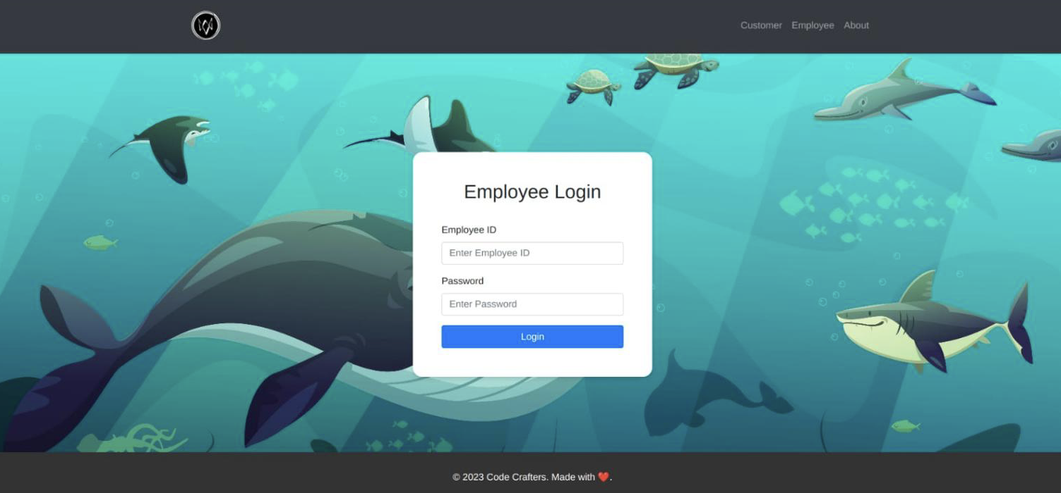
Pointers
Beautiful homescreen on the left and
Clean Employee login page on th

Slide 5
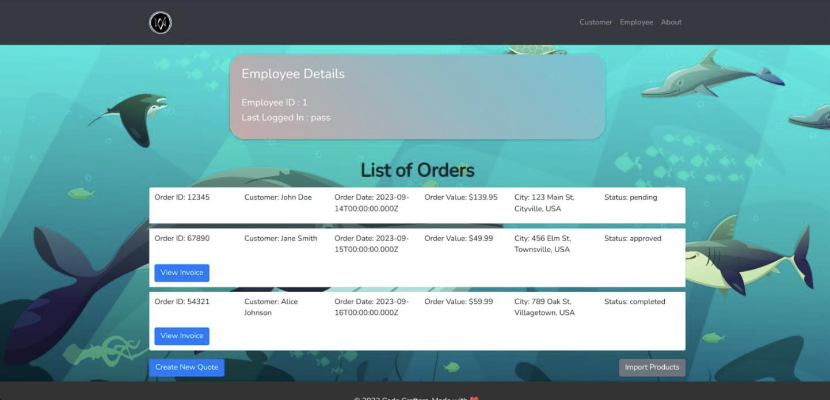
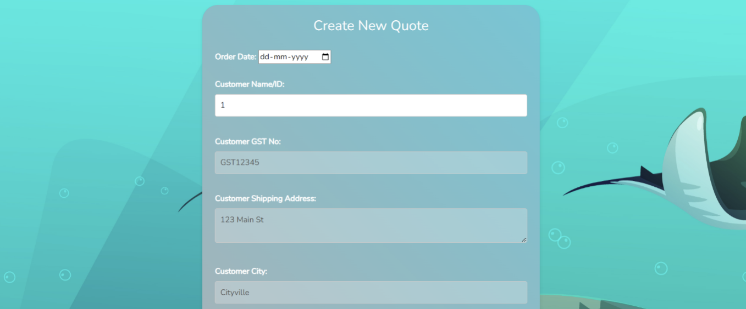
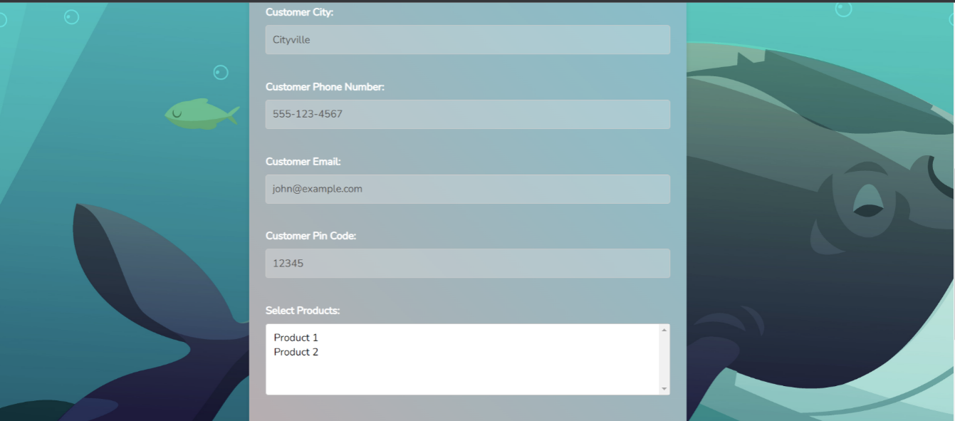
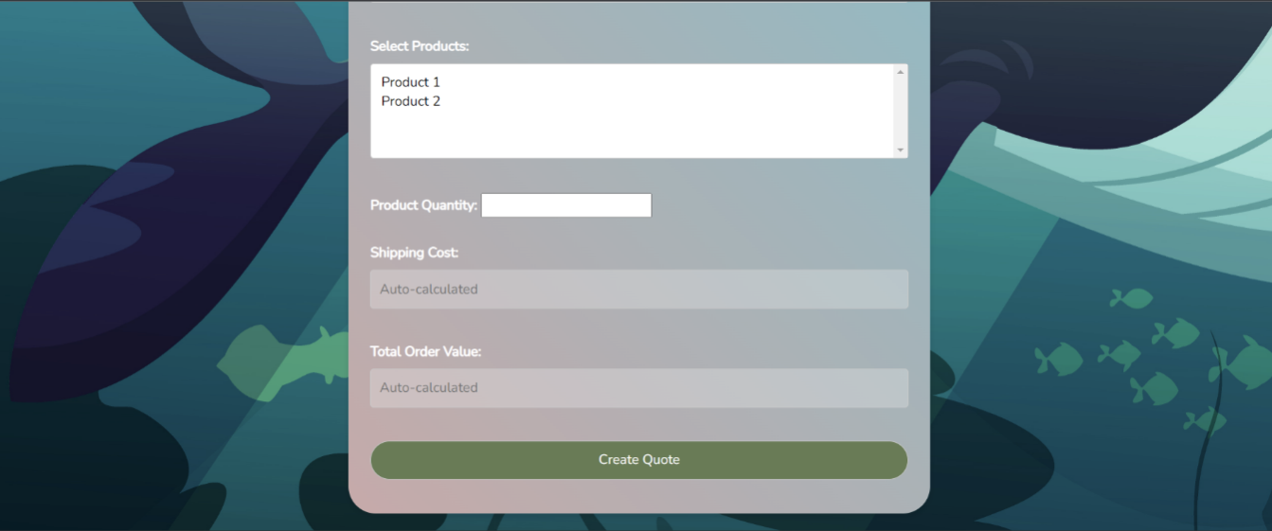
Pointers
List of Order, with “View Invoice”, “Create New Quote”, and “Import Products” option.
A form for the Employee to fill in order to create a new order.

Slide 6
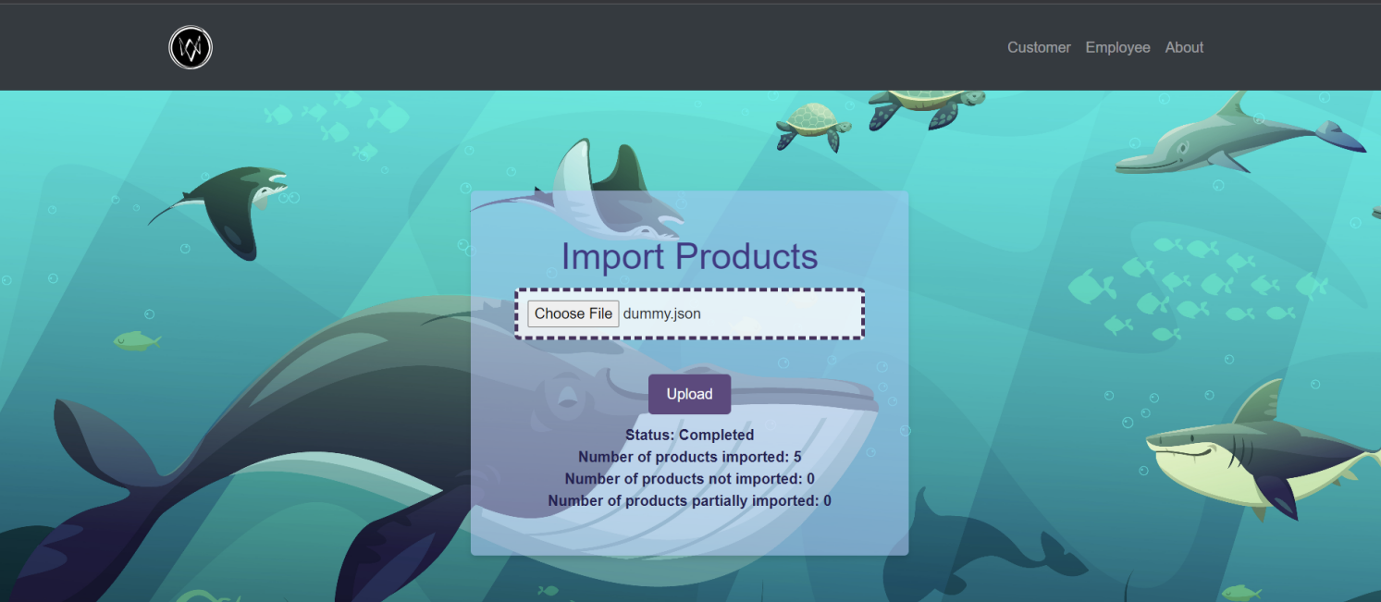
Pointers
Let’s the Employee upload either a JSON/XML file which will later be used to populate the date in the database.
Proper validation will be performed.

Slide 7
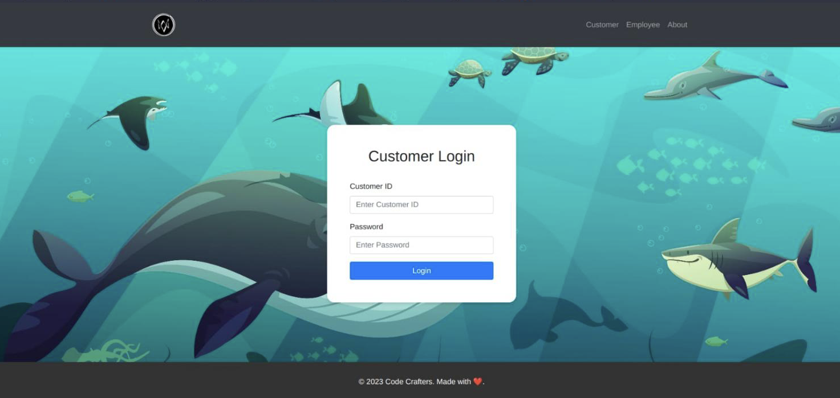
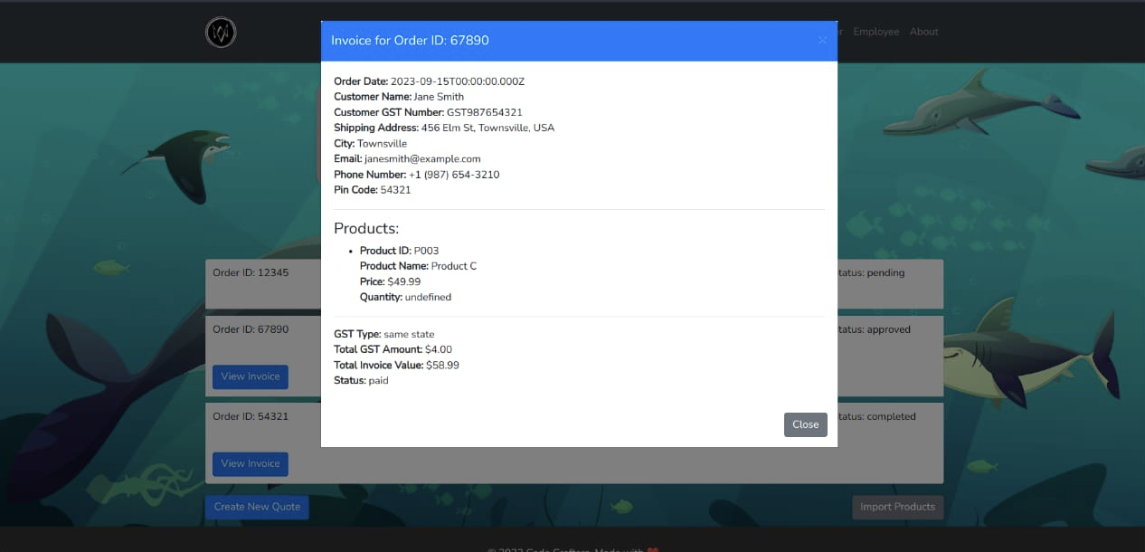
Pointers
Login screen for the customer to login in with (name, pass) or (id, pass).
Clean Invoice for approved or completed orders

Slide 8
But wait, a great front-end without a strong back-end?

Slide 9
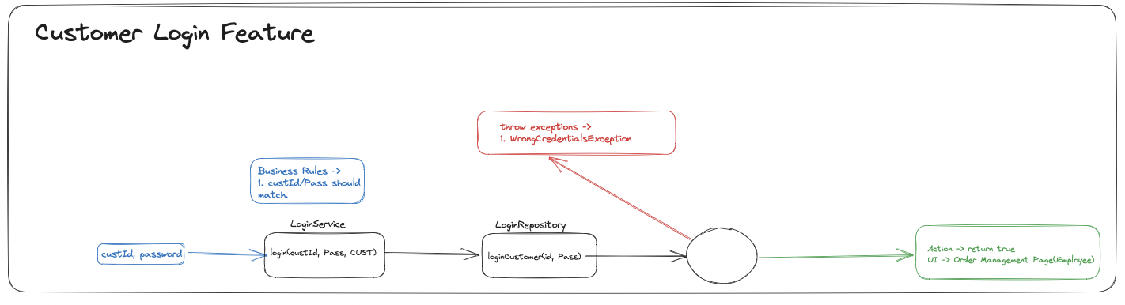
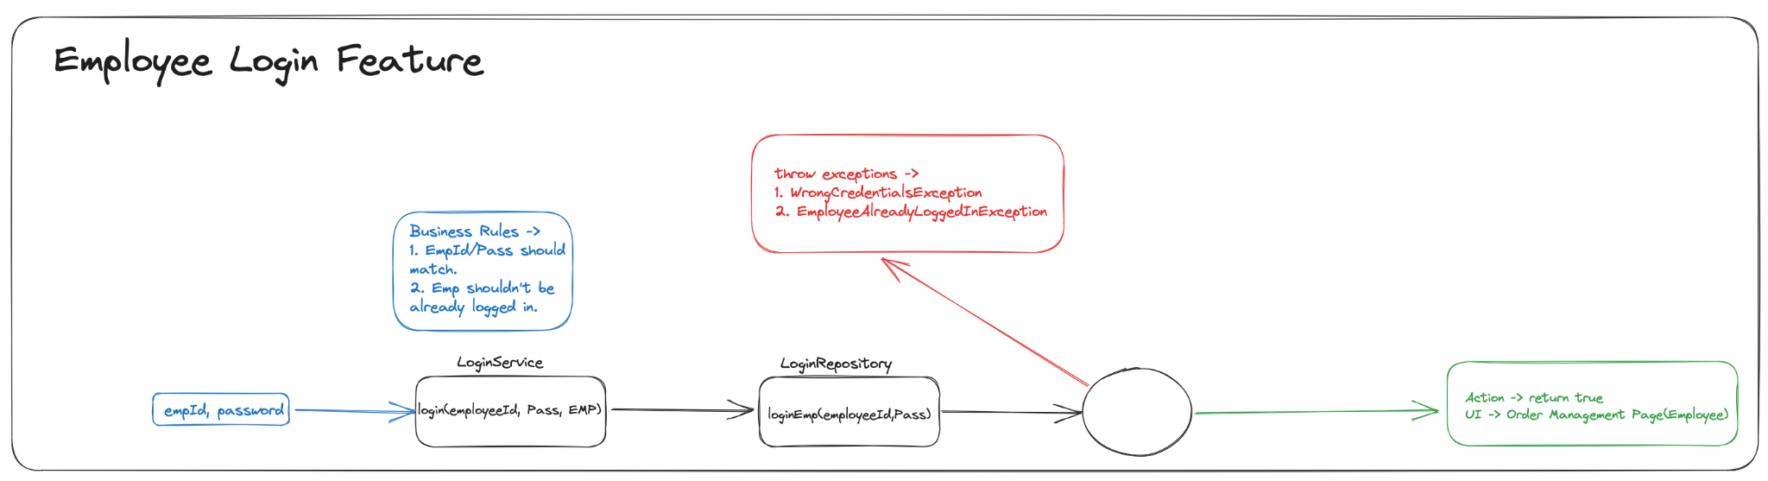
Tip
Detailed Customer and Employee login high level overview.

Slide 10
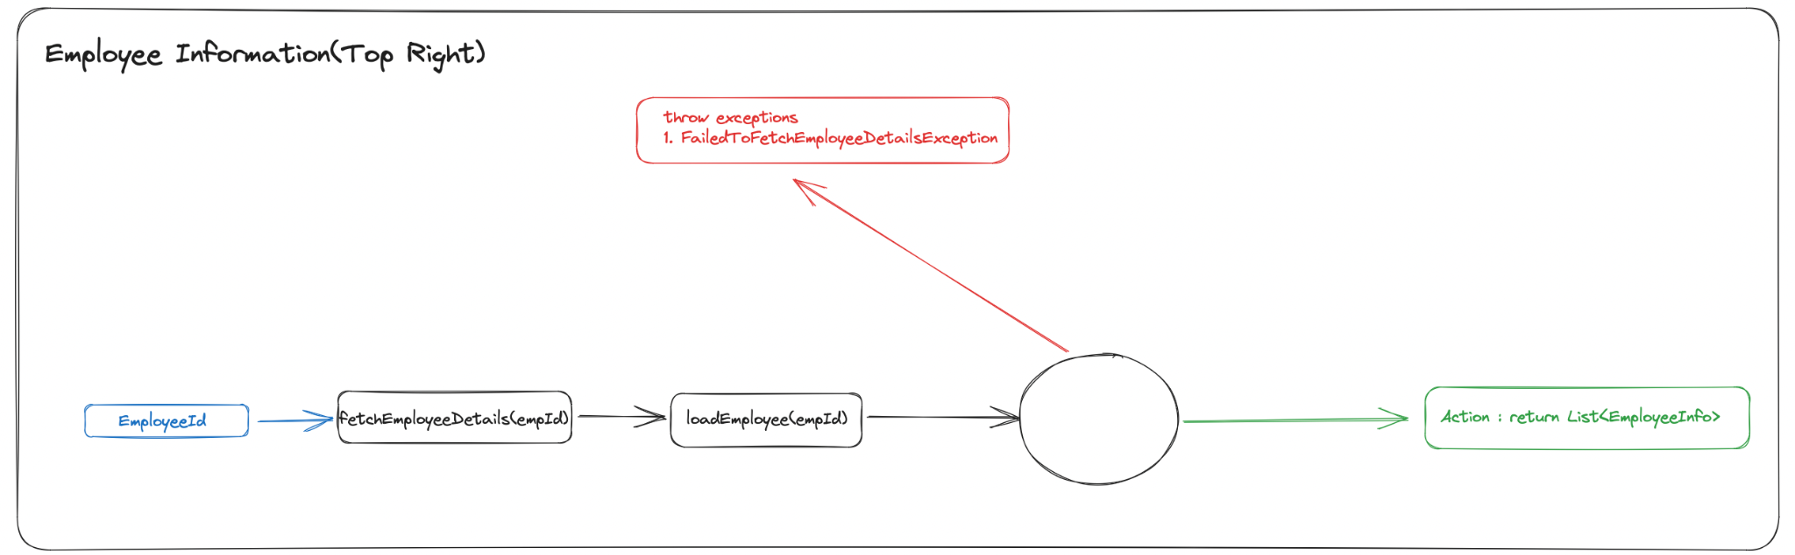
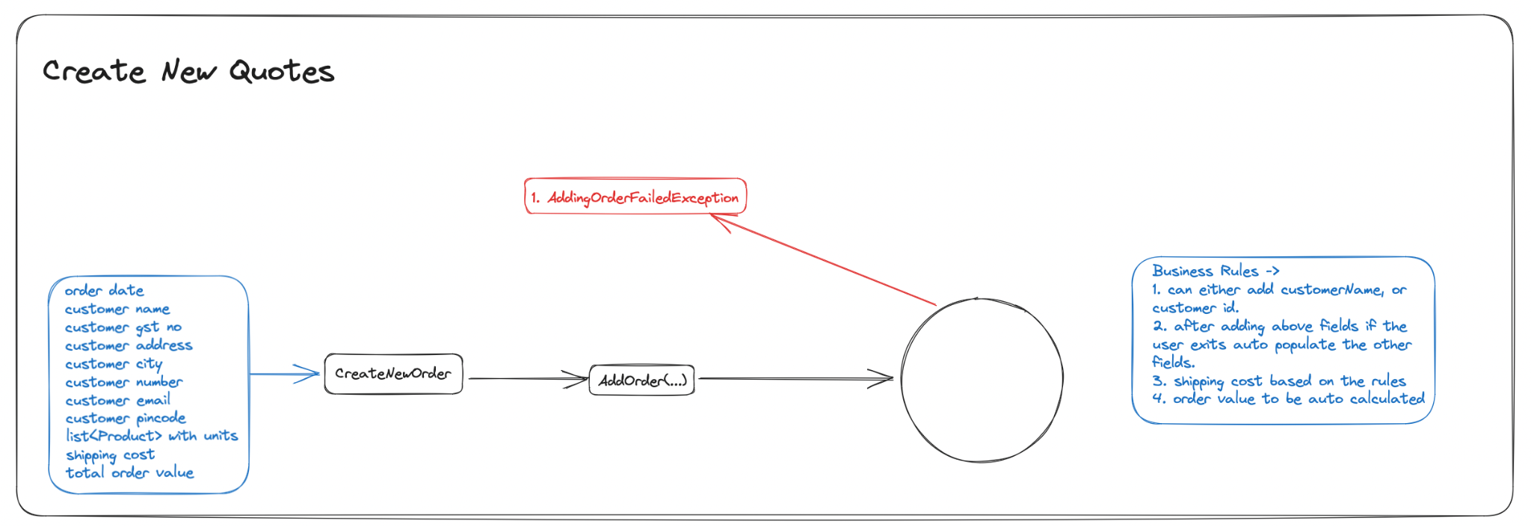
Tip
Employee Information to be displayed on top right.
Create new Quotes feature.

Slide 11
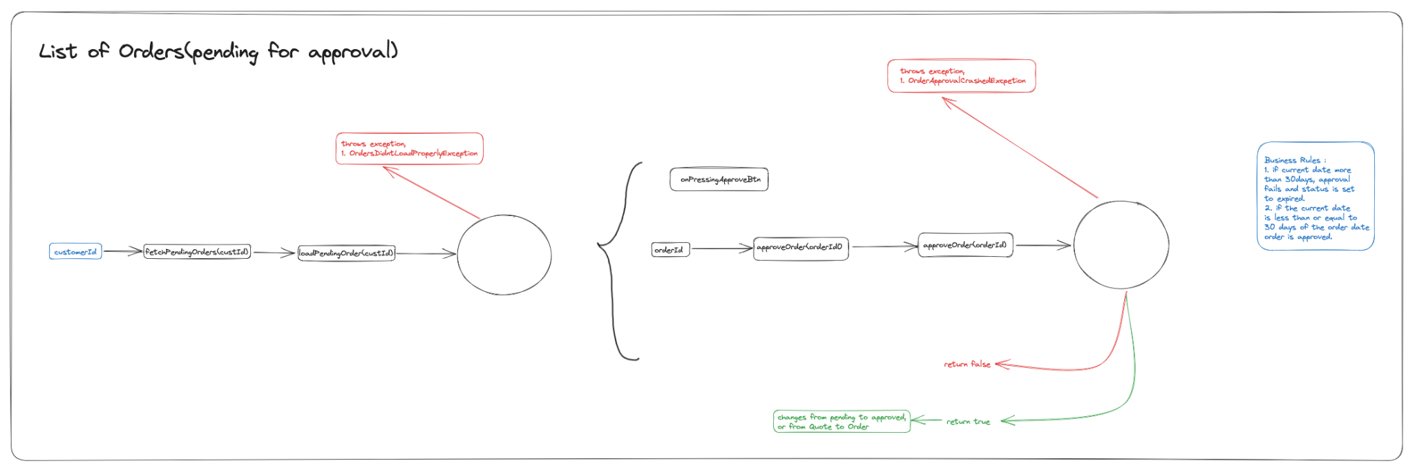
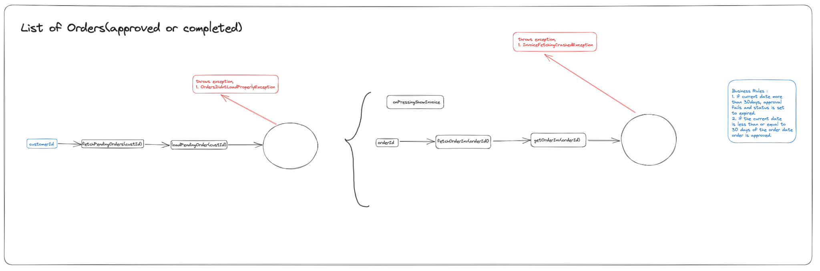
Tip
List of orders by customerID.

Slide 12
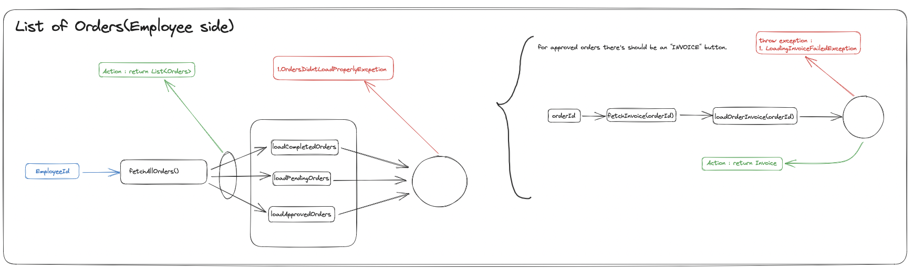
Tip
Flow to display List of orders to the employee and customer.

Slide 13
SQL Database
Started with proper designing and normalisation of the bare database models.
Benefit Made the process of accessing database much smoother and efficient.
Barrier Writing Prepared Statements was initially time consuming..

Slide 14
Thank you.
ARUN KUMAR, ARCHANA RATHORE, ASHISH PATWAL, GARGI DWIVEDI, RAMYA DANDU, SAMIKSHA MAHURE, VIDHI SAXENA, ABHISHEK GURURANI
_ CODE CRAFTERS

